Slide 1
Bounding Volume Hierarchies (BVH)
Alhajras Algdairy
Computer Science Department
University of Freiburg
Albert-Ludwigs-University of Freiburg

Slide 2
Outline
Overview
  Introduction
  Motivation
Bounding volumes BV
Bounding Volume Hierarchies Tree
University of Freiburg - Computer Science Department - Computer Graphics

Slide 3
Outline
Overview
  Introduction
  Motivation
Bounding volumes BV
Bounding Volume Hierarchies Tree
University of Freiburg - Computer Science Department - Computer Graphics

Slide 4
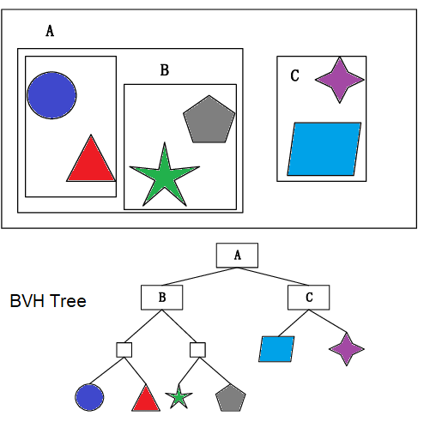
Introduction
BVH is simply a tree structure that represents geometric models with specific bounding volumes.
Alternative to space subdivision.
Fig. 1. An Example of The Bounding Volume Hierarchy in 2D.
Source: Yingsong Hu, Weijian Wang, Dan Li, Qingzhi Zeng, Yunfei Hu.
“Parallel BVH Construction Using Locally-Density Clustering”.
University of Freiburg - Computer Science Department - Computer Graphics

Slide 5
Motivation
Performance improvements.
Applications
  Collision detection (Simulation, Games).
  Ray tracing.
University of Freiburg - Computer Science Department - Computer Graphics

Slide 6
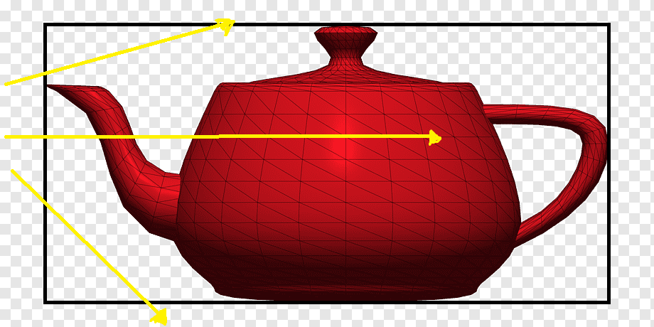
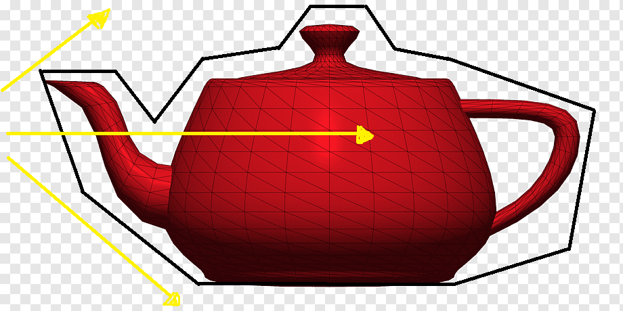
Motivation
Ray tracing: BVH reduces the number of intersection tests between rays and objects in scenes.
Fig. 2. BVH used on Utah teapot to improve the raytracing intersection test performance
University of Freiburg - Computer Science Department - Computer Graphics

Slide 7
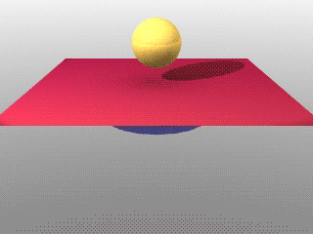
Motivation
Simulation: BVH reduces the number of the collision detection tests in simulation.
Fig. 3. BVH used for collision detection in simulation.
Source: Nicola L.K. Example of Cloth Simulation modelling. Wikipedia.
University of Freiburg - Computer Science Department - Computer Graphics

Slide 8
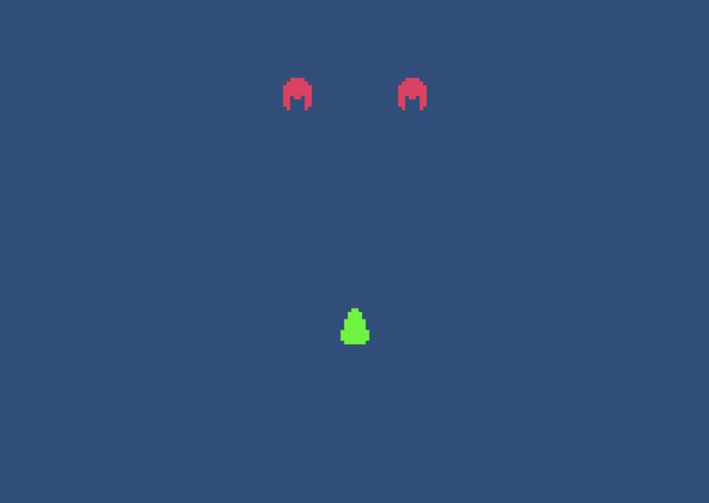
Motivation
Games: BVH reduces the number of the collision detection tests in games.
Fig. 4. BVH to enhance collision detection in ‘Sapce invaders’ game.
Source: Nicola L.K. Example of Cloth Simulation modelling. Wikipedia.
University of Freiburg - Computer Science Department - Computer Graphics

Slide 9
Outline
Overview
  Introduction
  Motivation
Bounding volumes BV
University of Freiburg - Computer Science Department - Computer Graphics

Slide 10
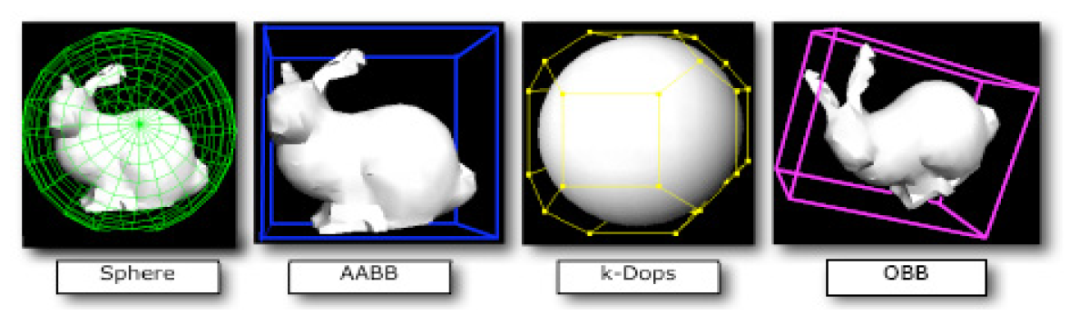
Bounding volumes BV
Bounding volume: It is the tightest possible virtual volume that wrap up an object.
Types:
    Spheres
    Axis Aligned Bounding Box (AABB)
    Discrete Oriented Polytope (k-DOP)
    Oriented Bounding Box (OBB)
Fig. 5. Common Bounding Volume in previous researches
(Suaib et al., 2008, Bade et al.,2006).
University of Freiburg - Computer Science Department - Computer Graphics

Slide 11
Outline
Overview
  Introduction
  Motivation
Bounding volumes BV
Bounding Volume Hierarchies Tree
  Tree construction
University of Freiburg - Computer Science Department - Computer Graphics

Slide 12
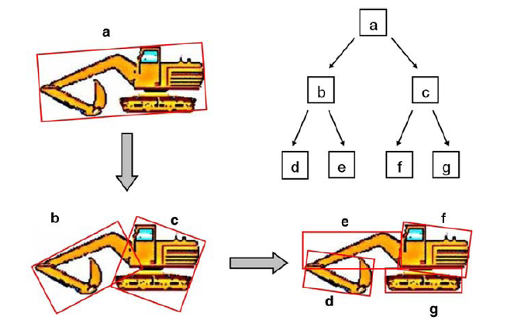
Tree construction
Constructed OBB tree using top-down approach.
Three different ways to construct a tree: Top down, bottom up, or insertion method.
Fig. 6. OBB tree recursively divides the object into two parts using binary tree and top-down approach (Kamat and Martinez, 2007).
University of Freiburg - Computer Science Department - Computer Graphics

Slide 13
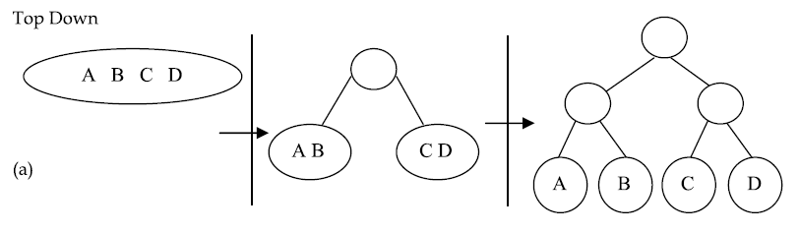
Tree construction
Top Down:
  Uses ‘fit and split’ algorithm.
  Arguably the most popular technique in practice.
Fig. 7.a. Hierarchy tree based of four objects using top-down (Ericson, 2004).
University of Freiburg - Computer Science Department - Computer Graphics

Slide 14
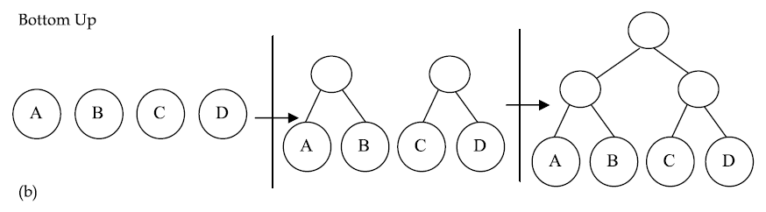
Tree construction
Bottom Up:
  Uses ‘knit and fit’ algorithm.
  Slower construction time than Top Down but usually produces the best tree.
Fig. 7.b. Hierarchy tree based of four objects using bottom-up (Ericson, 2004).
University of Freiburg - Computer Science Department - Computer Graphics

Slide 15
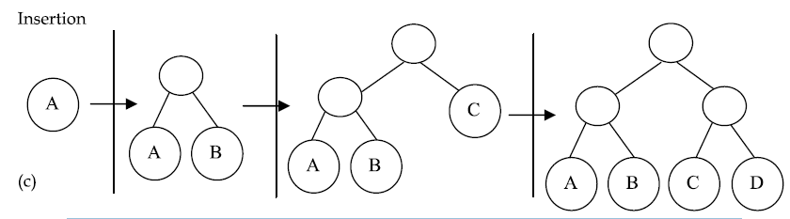
Tree construction
Insertion:
  Uses ‘incremental-insertion’ algorithm, where a cost function is used.
  Problem of this method is that it can become worst as it depends on the insertion order of the nodes, and it is challenging to find the best tree.
Fig. 7.c. Hierarchy tree based of four objects using insertion (Ericson, 2004).
University of Freiburg - Computer Science Department - Computer Graphics

Slide 16
Tree construction
University of Freiburg - Computer Science Department - Computer Graphics

Slide 17
References
Yingsong Hu, Weijian Wang, Dan Li, Qingzhi Zeng, Yunfei Hu. “Parallel BVH Construction Using Locally-Density Clustering”. School of Computer Science and Technology, Huazhong University of Science and Technology.
Fangkai Yang. “Collision Detection in Computer Games”. KTH Royal Institute of Technology.
Hamzah Sulaiman, Abdullah Bade. “Bounding. Volume Hierarchies for Collision Detection”
University of Freiburg - Computer Science Department - Computer Graphics

